Slide 1
Social Media and Video Marketing for the Public Sector – Developing a Strategic Approach to Communicate Effectively
Alistair Beech
12 June, 2019
Notes:
Introductory slide

Slide 2






Manchester
About your trainer
Alistair Beech
Senior Social Media
Coordinator,
Division of Communications and Marketing
Notes:
Bio. Experience using SM.

Slide 3
Social at The University of Manchester
100+
key social channels across campus
Community
of over
1 million
users
Hub of social media professionals
Enteprise-level management tool
Social Listening Tool
Social Advocacy Programme
Notes:
Like many peers in the sector, Manchester has a number of social channels which serve multiple audiences, including staff, students, alumni, business, research, local and international partners. We have over 100 key channels, managed across the campus by trained practitioners from within Hootsuite Enterprise.
The social media team in the central Division of Communications and Marketing maintain online communities totaling over a million users; one of the largest social media community within the Russell Group, with Oxford, Cambridge the largest social communities.
We have an active, engaged practitioner network who manage social media at the University. Some staff are dedicated to digital communications, but many that do it alongside / on top of other responsibilities. Central to the success of the network is the training and support offered via our Staff Learning and Development programmes. In 2018 we trained 160 support staff in social best practice, including audience engagement and content strategy.

Slide 4
Key learning objectives
Actionable insights to help you plan a strategic, long-term way of approaching and using social media within your organisation
Think about social media in new ways – start making progress straight away whilst working towards larger objectives

Slide 5
Manchester
Icebreaker…

Slide 6
Manchester
Social media and the public sector
Notes:
Why social media is so important for the public sector
The current state of social media in the UK public sector today
Organisations leading the way and what we can learn from them
The public sector problem – internal barriers, the lack of executive buy-in for social media and top tips and tactics to overcome them

Slide 7











The evolution of social media
Reconnecting& developing online self
Push messaging – catch-all
Two-way social conversations
Targeted, audience-specific messaging
Audience as content producers
Premium content
2003-2004
2019-

Slide 8
Why social media is so important for the public sector
Cheap way of
reaching target
audiences and
delivering
services
Accessibility,
low barrier
to entry
Necessity
(not totally free)

Slide 9

Why social media is so important for the public sector
70%
of the UK population have a social media account
39 minutes a day on social
Online over 3 hours a day
70% internet use is video
92%
use YouTube monthly
Source: Ofcom, Online Nation report, 2019
Notes:
Internet use is rising. On average the UK adult is online for three hours 15 minutes – that’s up 11 minutes.
Social media use remains buoyant. A total of 70 per cent of the population have a social media account and use it regularly. That’s 39 minutes of use a day.
But more people have a concern about the internet. Overall, 78 per cent had a concern about an aspect of the internet. Strikingly, younger people are seeing the downside far more. Compared with 61 per cent of adults having a negative online experience 79 per cent of 12 to 15-year-olds have had a poor experience. That’s everything from an unwanted friend request to bullying or trolling.
Video IS becoming the internet. In the UK, 70 per cent of internet use by bandwidth is video. That includes streaming services, video calls and online videos. And 92 per cent of internet users use YouTube monthly with the platform on average being watched 27 minutes a day.
Music video tops the You Tube chart as the most popular use but how-to guides are not far behind. Music video accounts for 62 per cent of use with 57 per cent ‘how to’ with 40 per cent general search.
Home internet and 4G penetration remains high. In the UK, 87 per cent of homes have a broadband connection with 82 per cent broadband and 70 per cent using 4G.
General web communications remains high in the UK. Email remains popular with 74 per cent using them weekly with 49 per cent using messaging apps and 73 per cent using search.
Facebook continues to dominate. Despite a hectic few years the platform remains the giant that bestrides the media stage. Critics would point to the fact that the platform’s penetration amongst internet users is down from 95 per cent to 88 per cent. Supporters would point to the fact that even with this fall the numbers dwarf the competitors.

Slide 10
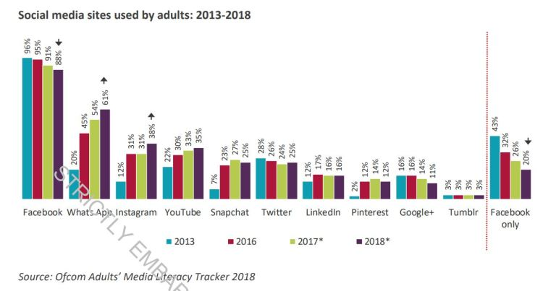
Notes:
40m people use FB in the UK. 88% of adults use it, many within community or interest groups.
Only 20% use it on it’s own. Growth in WhatsApp, IG over last year.

Slide 11
The current state of social media in the UK public sector today
Too much broadcasting – deliver key messages and campaigns in interesting ways
Engagement should be monitored and measured – genuine engagement with customers / key audiences
Poor performing accounts = time wasted – don’t cling on to accounts for vanity reasons or those that don’t add value
Questions and DM’s should be answered by the right teams – not always comms/marketing – most enquires are customer related and should be dealt with by the experts
Source: Public Sector social media trends, Comms2Point0, 2017

Slide 12
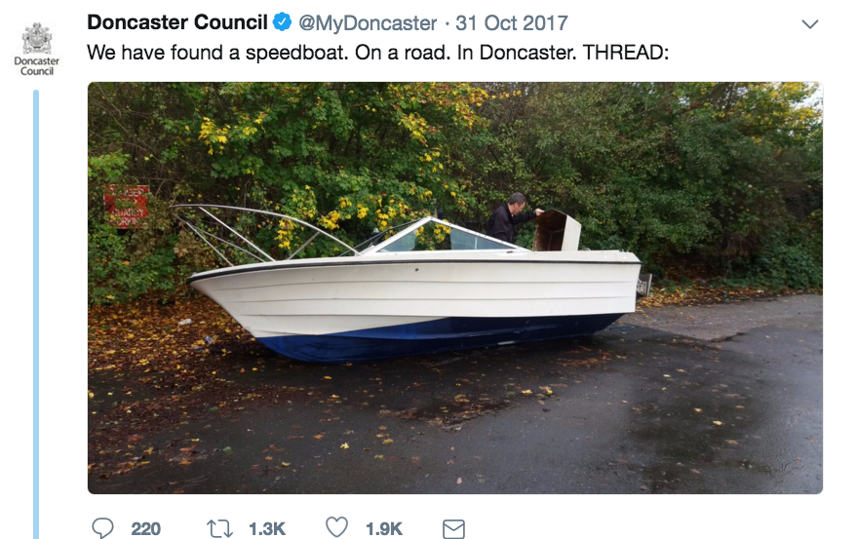
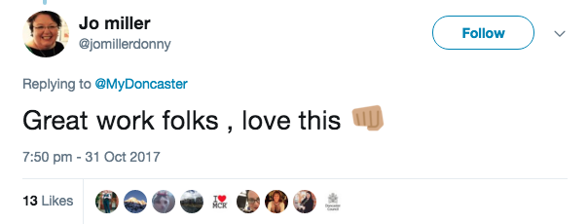
Who’s leading the way?
Notes:
CLICK THROUGH https://twitter.com/MyDoncaster/status/925388665278386176
If you’re looking for some inspiration around Twitter Threads, take a look at Doncaster Council. Their strategy involves being human, funny, a little cheeky and very different to how many council’s behave on social media.
This isn’t a throwaway thread - they run a weekly series called #TuesdayTales – telling stories about everyday council business in a fun and friendly way. This thread led to a phone-in discussion on BBC Radio 5 Live and coverage in daily newspapers.
It isn’t isolated - their chief exec is on Twitter.

Slide 13
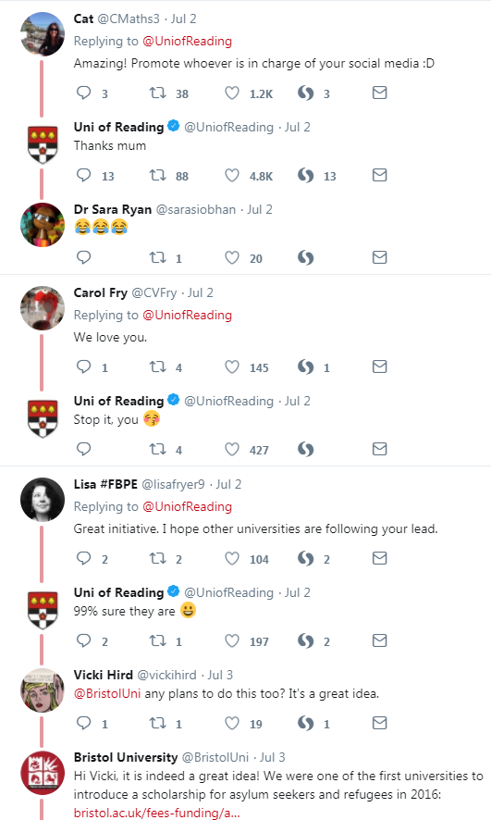
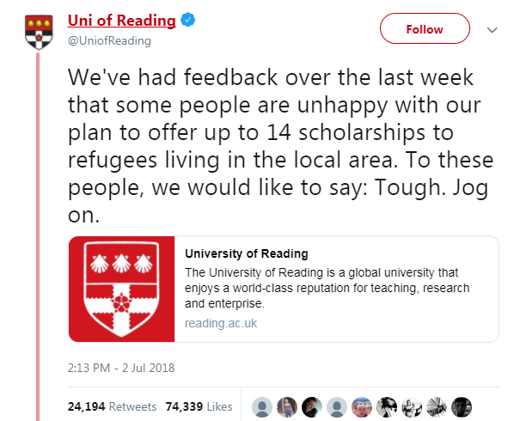
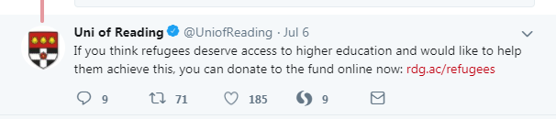
Who’s leading the way?
Notes:
https://twitter.com/uniofreading/status/1013772777130807304

Slide 14
Who’s leading the way?
Customer
focused
Emphasis on
internal and
external content
Evaluate
audiences and
content
Notes:
Summary slide - what we can learn from them
Customer – you’ll find both accounts full of conversations, with customer service enquiries and back and forths at the forefront (particularly on Twitter). They’ve also developed a tone of voice, which takes time. Reading took the decision to switch from publishing to conversation lead content.
Int/Ext – both organisations regularly piggy back on external events/hashtags with relevant or simply humourous content. People use social media to get questions answered quicker than email/phone or be entertained.
Evaluate – both accounts work out successful posts, why they were successful on particular channels and repeat them. Doncaster found 95% of the Facebook fans were in Don/Yorkshire, whereas on Twitter is was less than 50%. Twitter content became broader than local content on FB.

Slide 15
Manchester
The public sector problem – internal barriers, the lack of executive buy-in for social media and top tips and tactics to overcome them
Notes:
Why social media is so important for the public sector
The current state of social media in the UK public sector today
Organisations leading the way and what we can learn from them
The public sector problem – internal barriers, the lack of executive buy-in for social media and top tips and tactics to overcome them

Slide 16
Internal barriers to development
Time
Trust
Training
Technology
Source: Public Sector social media trends, Comms2Point0, 2017
Notes:
Time – it takes years to grow and develop SM audiences, and every post (organic and paid) counts. You also need at least one member of staff who manages activity, and additional staff who can contribute. Leaving it to one person and not getting everyone trained up is dangerous – what happens when they’re on leave or get another job?
Trust – trust in online services to protect user data/use it responsibly varies significantly. Among ten leading UK sites, trust among users of these services was highest for BBC News (67%) and Amazon (66%) and lowest for Facebook (31%) and YouTube (34%). There can be a lack of trust at senior level to it’s benefits. We have that at the University. Only 3 out of 12 SLT have active social media accounts. It’s a slower process to build trust and advocate it’s use at the highest level.
Training – it’s such a new industry, how are staff able to stay at the cutting edge, and how is that scaleable across the organisation? The channels, and audience expectations change so much, training has to be reviewed at least once every six months.
Technology – how do your existing marcomms tools integrate with social media? For ROI reporting - is your CRM linked to your social media management tool? At a more basic level, is social media use blocked at your organisation? Are smartphones available for comms staff to use on the move?
Money / resources
Fear / specitcism ‘we don’t do that here’
Lack of measurement / ROI

Slide 17
Internal barriers to development
Lack of budget
Old fashioned thinking
Lack of understanding of the value of social media
Difficulty in proving the value through measurement and tying social value to business objectives
Lack of training and in-house expertise
Notes:
Tactics to overcome these barriers:
Start small with budget requests
Tie all activity to specific business objectives and prove the value of social
Get around the business and talk to senior directors about how social can help them
Form a Social Media working group that includes non-comms/marketing people
Utilise free training online and free conferences and events
Ask to present to senior leadership on what you’re doing on social
Send regular updates round the building on what you’ve been doing on social to increase visibility
Knowledge Sharing - Ask social media experts from other institutions to visit or if you and your teams can visit them

Slide 18
Tactics to overcome these barriers
Prove the value of social
Talk to senior
leaders about social
Form a social media working group
Build a social media pack
Knowledge sharing
Tie activity to
business objectives
Leverage expertise
from around business
- include
non-comms/marketing
staff
Tap into online resources,
conferences, peers
Notes:
Tactics to overcome these barriers:
Start small with budget requests
Tie all activity to specific business objectives and prove the value of social
Get around the business and talk to senior directors about how social can help them
Form a Social Media working group that includes non-comms/marketing people
Utilise free training online and free conferences and events
Ask to present to senior leadership on what you’re doing on social
Send regular updates round the building on what you’ve been doing on social to increase visibility
Knowledge Sharing - Ask social media experts from other institutions to visit or if you and your teams can visit them

Slide 19
Manchester
Workshop: identifying and overcoming internal barriers to development
Notes:
Attendees will split into groups to identify 3 most common internal barriers to social media development within their organisations
TEMPLATE SHEETS
Money / resources
Fear / specitcism ‘we don’t do that here’
Lack of measurement / ROI

Slide 20

Notes:
AB. 5 MINUTE BREAK.

Slide 21
Manchester
The socially mature organization and how public bodies can transform

Slide 22
Manchester
Social media is more than a communications, marketing or customer service tool…
it’s a business tool that can integrate across entire organisations to meet key business objectives

Slide 23
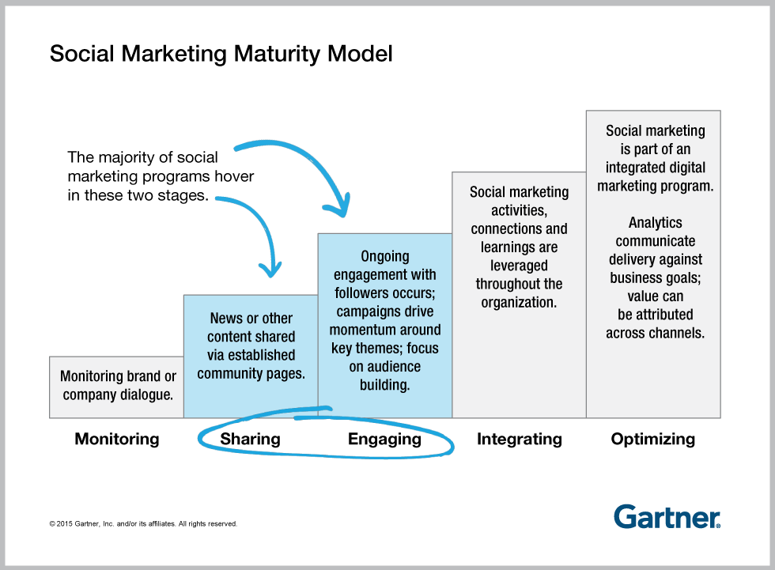
Manchester
The socially mature organisation
Notes:
Introduction to the social media maturity model and why it matters
How you can assess your social maturity and start to plan change
The road to transformation – why long-term ‘thinking’ and short-term ‘doing’ is key

Slide 24
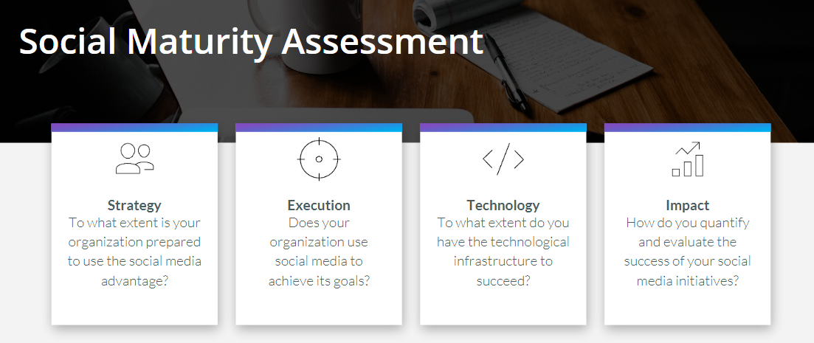
Manchester
Source: Hootsuite, 2019
Notes:
Introduction to the social media maturity model and why it matters
USE HOOTSUITE MODEL

Slide 25
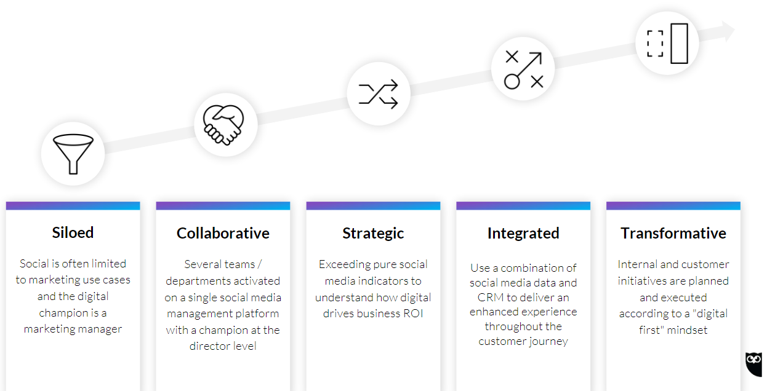
Manchester
The socially mature organisation
Source: Hootsuite, 2019
Notes:
Introduction to the social media maturity model and why it matters
USE HOOTSUITE MODEL

Slide 26
Manchester
Exercise: Using the SWOT analysis, assess your organization’s social maturity using the five steps in Hootsuite’s maturity map
Notes:
How you can assess your social maturity and start to plan change
How will you start to plan change and get to the next level?
SILOED
COLLABORATIVE
STRATEGIC
INTEGRATED
TRANSFORMATIVE

Slide 27
Manchester
The road to transformation
Define a long-term vision for how you want your organisation to use social media
Define a plan for how you’re going to get there
The plan should be broken down into as many component parts as possible
Start doing something this week, next week and next month that will start you on the journey to developing how your organisation uses social media
Notes:
The road to transformation – why long-term ‘thinking’ and short-term ‘doing’ is key
Defining a long-term vision for how you want your organisation to use social media
Define a plan for how you’re going to get there
The plan should be broken down into as many component parts as possible
Start doing something this week, next week and next month that will start you on the journey to developing how your organisation uses social media

Slide 28
Manchester
How to develop a social media strategy in your organisation
Notes:
Why a strategic approach to social media is so important
What a social media strategy should include (and what it shouldn’t)
Why a social media strategy is different to other organisational strategies
The 10 step approach to start creating or developing your social media strategy

Slide 29
Manchester
10 step approach for strategy development
Notes:
ASK THE DELEGATES

Slide 30
The below can apply on an organisational level, individual department or team. The principle and the process is the same.
Define your why
Broad objective setting
Business-specific objectives
SMART
goals
Audit
Why are you using
social media?
Tie to organisational
goals
Work out where
you are
Notes:
Define your why. Why are you using social media? What is the broad purpose of your activity?
Broad objective setting - define specific objectives you want to achieve. These guide everything else.
Business-specific objectives - now tie your objectives to your organisations business goals. If an objective doesn’t fit, get rid of it.
SMART goals. Now you have you goals to business objectives, make them SMART - put them into SMART principle structure. This helps you define WHAT SUCCESS LOOKS LIKE - this is critical.
Audit. Now you know where you want to go, work out where you are. This includes reviewing all channels, content, people, skill levels and systems, and can include your social media maturity assessment outcomes.

Slide 31
Quick wins
Define your who
Choose your
channels
Review, revise, repeat
Measurement
Who is your audience?
Create personas
Define where to focus
your efforts
Notes:
Quick Wins. You know where you want to go. You know where you are now. Are there things you can change quickly? Write them down and get going on them.
Define your who. Who is your audience? Be specific. Create personas. As many different audience types as you think is relevant.
Measurement. Define how you are going to assess your goals, how often and who is responsible for tracking and reporting on the goals.
Choose your channels. Now you know your audience. You know what you want to measure to define success. Now define where you are going to focus your efforts. Tie your SMART goals to your channels and define how each goal should be achieved through each channel.
10. Review, revise, repeat. You will never get it right first time. Define your strategy. Start doing and test and refine regularly. Aim to make it more relevant each time.

Slide 32
Why a strategic approach to social media is so important
Reporting
Show value
Tie to marcomms and business goals
Makes senior buy-in easier
The
four T’s
Notes:
AB.

Slide 33
Manchester
What should a social media strategy include?
Notes:
ASK THE DELEGATES

Slide 34
What should a social media strategy include?
Clear and
actionable
KPIs /
measurements of
success
Channel specific
objectives and
tactics
A clear timeline
with specific
milestones
Where you can, tie your social strategy to business outcomes
Notes:
High level stats – e.g. channel growth, engagement figures, audience profile.
Objectives – we use Facebook to…
Definition of goals – by 2020 we want to increase X by X.
Tone of voice
Content measurement – we post this type of content, because…
Some competitor benchmarking – high level, make it applicable to what you’re asking for. E.g. our top three competitors have higher engagement levels through more attention on video – we require investment in this area to keep pace.

Slide 35
Example strategy framework
Reporting
Show value
KPIs and procedures feed into marcomms annual plan
Individual channel strategies reviewed quarterly
Wider organisational business strategy
Social Media Manager
(alongside
business leads)
Director of Communications
and Marketing
Chief Exec/
Operating Officer
Notes:
AB.

Slide 36
Considerations
Who is the strategy aimed at / for? Who will access it?
How often will it be reviewed and who is responsible for the review?
How does it fit with the overall marcomms and business plans?
How will you make it relevant for senior staff? Do you need senior sponsorship?
Can you turn it into an elevator pitch? (towards senior staff)
Notes:
AB.

Slide 37
Manchester
What should a social media strategy not include?
Notes:
ASK THE DELEGATES

Slide 38
Not for the strategy doc
Details of staff social media policy (reference it, but HR should own it)
Granular details of content performance or audience groups – keep it high level
Governance or training information – keep this separate in shared internal areas
Notes:
AB.

Slide 39
Notes:
LUNCH

Slide 40
Manchester
Workshop: developing your social strategy
Notes:
10 step approach to creating a social media strategy

Slide 41
Social media campaign and content planning
Notes:
Why everyone should spend more time planning content!
The 8 step process for effective social media campaign planning

Slide 42
What tools do you currently use?
Notes:
Why everyone should spend more time planning content!
The 8 step process for effective social media campaign planning

Slide 43
Tools for planning your content calendar
Outlook / Google Calendar
Social media tool - Hootsuite
Excel /
Google Sheet
Project tool – Trello/Airtable
Notes:
AB.

Slide 44
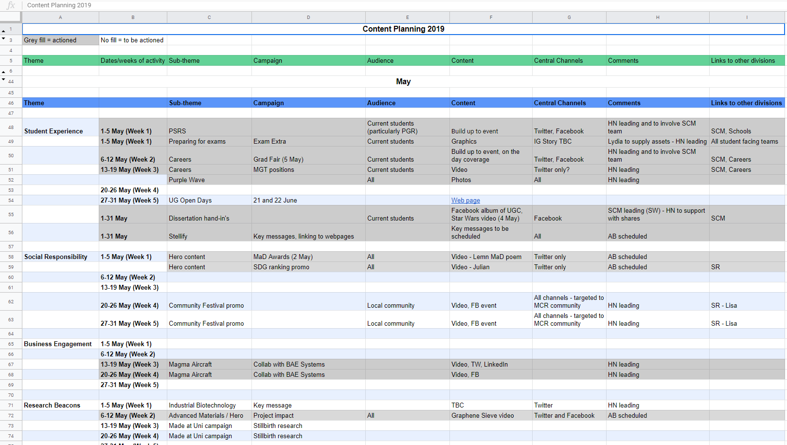
Notes:
AB. TEMPLATE https://docs.google.com/spreadsheets/d/1PwCkB7znn2qHQiSg_aADtMWnrLsThlSAGk3_jzm0-6s/edit?usp=sharing
Essentially a document that organizes the timing of your content production, publishing, distribution, and can even include your measurement efforts.
Shows what specific content is being produced and published by your team and it will outline timing of this process, content ownership and other details involved with your content.
It's a living document that should change over time as campaigns get altered, dates gets delayed, content gets improved, etc.
It should be customized to meet your team’s needs and aligned with how your team will actually use it on a regular basis.

Slide 45
Pros/cons
 | Google/Excel Spreadsheet | Google/ Outlook Calendar | Project Management Tool (e.g. Trello)
Pros | Low barrier to entry Simple set up No cost Very flexible | Free and easy to use Mobile friendly Easy to share | Free version has lots of features Good for assigning tasks and alerts
Cons | Limited scalability Need to manage permissions | Limited capability Limited collaboration | Adoption period required for newbies Not great for scalability
Best for | Spreadsheet fans or small teams looking for flexible option | Team of one who feels confident operating with basic level of detail | Teams with lots of contributors who are willing to adopt the tool
Notes:
AB.

Slide 46
Staying organised
Who will be responsible for updating the calendar?
Do the posts need to be approved by someone before going live?
If yes, who will be responsible for proofreading, sourcing images, scheduling, etc.?
Archive/hide old sections but be sure to keep the parts that will come in useful for next years calendar
Notes:
AB.

Slide 47
8 step process for effective social media campaign planning
Goals
Theme and concept
Audience
Creative / voice
Engagement and response
Timeline
Measurement
What’s next?
Notes:
AB.
GOALS – SMART (Lead gen, awareness, click throughs, engagement, social care)

Slide 48
Moving beyond Facebook and Twitter
Notes:
Overview of some non-traditional channels, covering Instagram, LinkedIn and WhatsApp
How to research, identify whether channels are right for your organisation and how to create a strong business case for using new channels
Case studies on UK public sector organisations using these platforms well
Tips and guidance on how to effectively test additional platforms without wasting time

Slide 49
The evolution of social media
Reconnecting& developing online self
Push messaging – catch-all
Two-way social conversations
Targeted, audience-specific messaging
Audience as content producers
Premium content
2003-2004
2019-

Slide 50
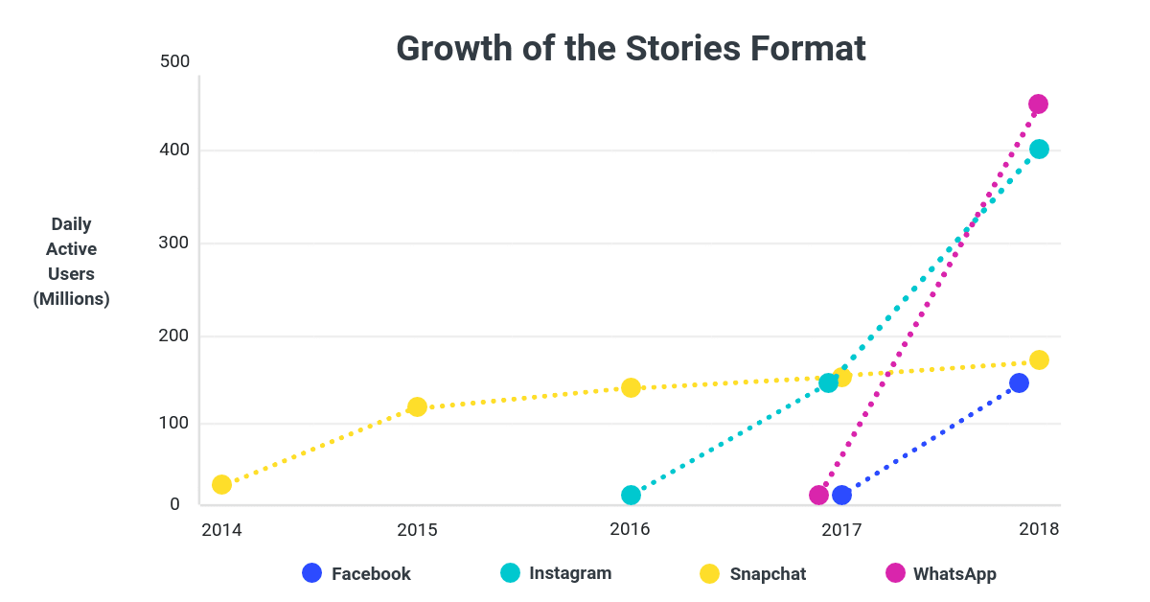
Stories growing 15x faster than feed-based sharing
Source: Block Party
Notes:
Overview of some non-traditional channels, covering Instagram, LinkedIn and WhatsApp
Instagram is the number one University social channel to reach Manchester students, have almost 35,000 followers and receive over 30,000 engagements per month (likes, comments, shares). Stories gain more views and engagement than news feed posts
There are 400 million daily active users of Instagram Stories, overtaking Snapchat in less than 12 months.
Better data from Instagram than Snapchat – the students we speak to say Snapchat is too young for them now.
80% of all daily active Instagram users are watching Stories just as often as they’re checking their feed.
Facebook investing more attention/resources into Stories – format isn’t going to go away.

Slide 51

Visual influencer
– becoming an
all rounder
1. 400+ million users watch stories
2. Great source of
UGC
3. 80% users
follow a brand
Professional
connector
1. Most trusted
social network
2.Highly targeted
ad products
3. Intention-driven
(careers,
Inspiration)
In the moment
engager
Popular, quick,
customer-driven
2. Good in
emergencies
3. In infancy within
most orgs
Notes:
Overview of some non-traditional channels, covering Instagram, LinkedIn and WhatsApp

Slide 52
How to research, identify whether channels are right for your organisation and create a strong business case for using new channels
Notes:
Overview of some non-traditional channels, covering Instagram, LinkedIn and WhatsApp
How to research, identify whether channels are right for your organisation and how to create a strong business case for using new channels
Case studies on UK public sector organisations using these platforms well
Tips and guidance on how to effectively test additional platforms without wasting time

Slide 53
Will the new channel improve business outcomes?
How will it be maintained and championed internally?
Audit existing channel performance
Resources and training
Trial with key audience groups
What does success look like?
Review quarterly and share findings upwards
Notes:
How to research, identify whether channels are right for your organisation and how to create a strong business case for using new channels

Slide 54
Case study – Met Office
Notes:
Case studies on UK public sector organisations using these platforms well
Tips and guidance on how to effectively test additional platforms without wasting time

Slide 55
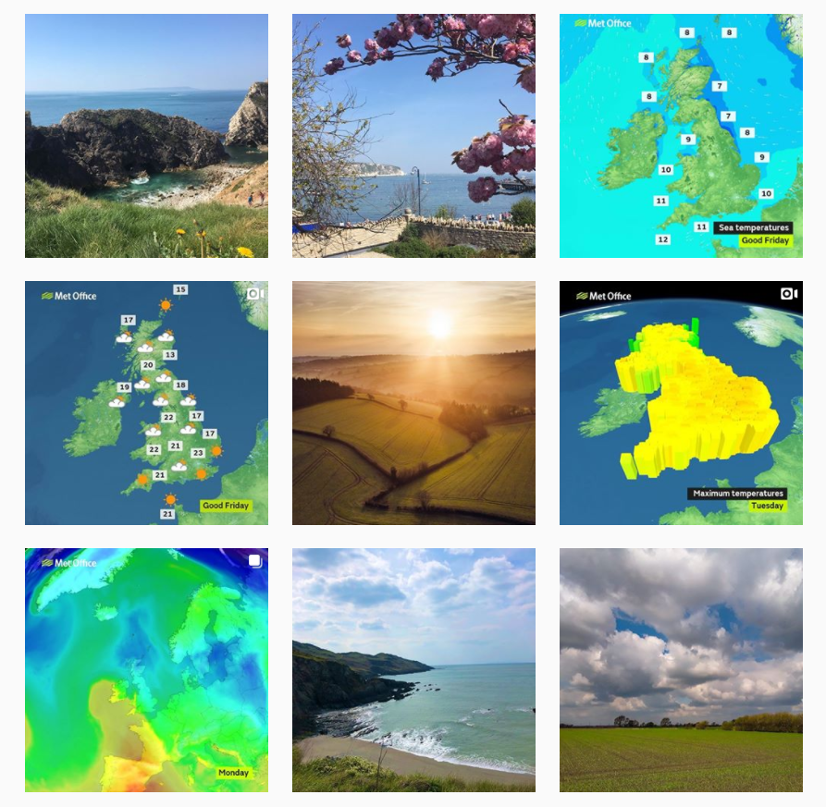
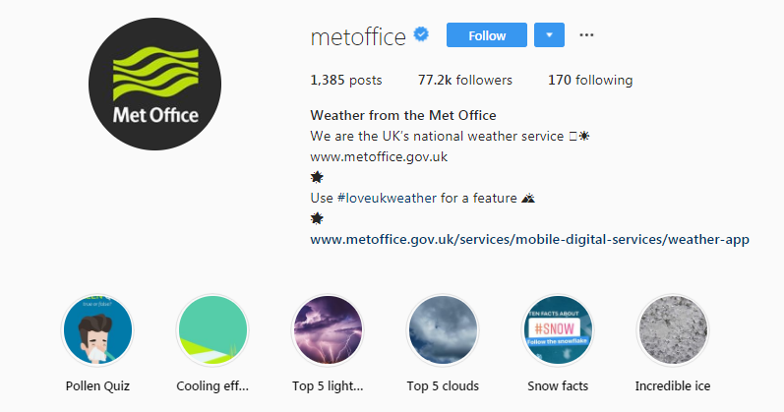
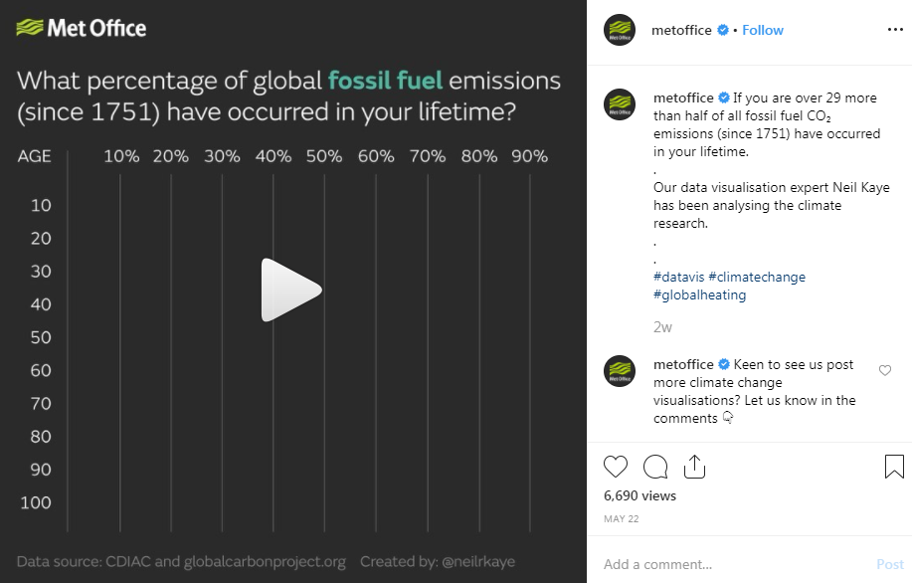
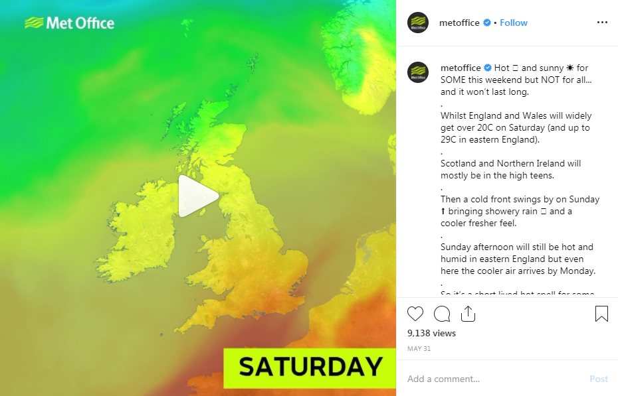
Notes:
https://www.instagram.com/p/ByIM3qlBPD3/
https://www.instagram.com/p/Bxw_XSFh6tw/

Slide 56
Case study – Royal Navy
Notes:
Case studies on UK public sector organisations using these platforms well
Tips and guidance on how to effectively test additional platforms without wasting time

Slide 57
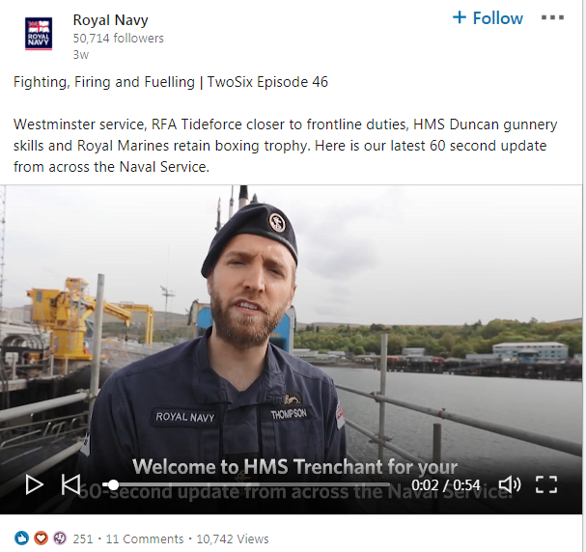

Notes:
https://www.linkedin.com/feed/update/urn:li:activity:6534101990908149760

Slide 58
Testing new platforms
Do some audience research (or even better) poll or survey your customers to understand if the platform is regularly used
Pick a campaign or initiative that aligns itself to a new channel – e.g. WhatsApp broadcast channel for summer graduation and set some objectives/goals and a timeline
Write a one-side briefing document for staff who will manage it and train them up – set up a test account and make sure it works
When you know it works, get the appropriate approval – highlight how it will improve business outcomes and do something better than an existing channel could
Notes:
Tips and guidance on how to effectively test additional platforms without wasting time

Slide 59
Manchester
Why video is critical on social
Notes:
Overview of why video is so important to social media and marketing content in 2019
Case studies of organisations using video effectively
Practical tips on how to create better video on a small budget

Slide 60

Manchester

Slide 61
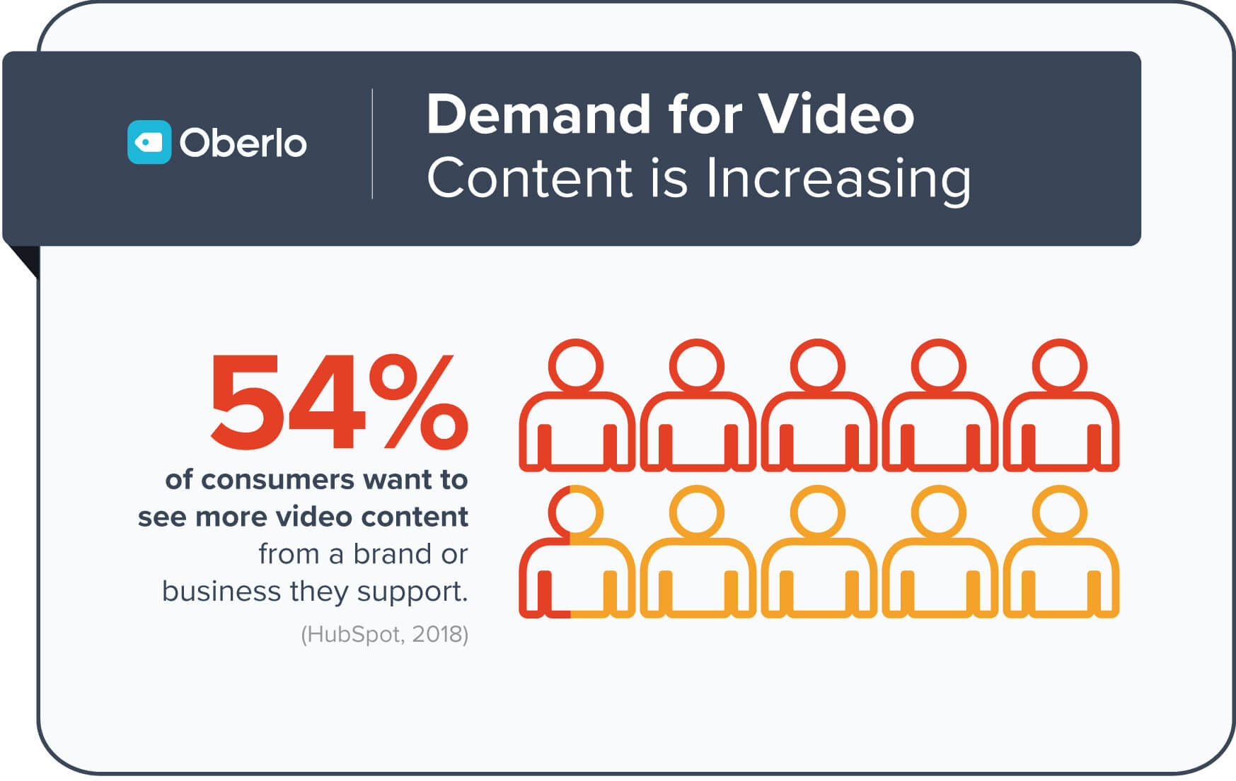
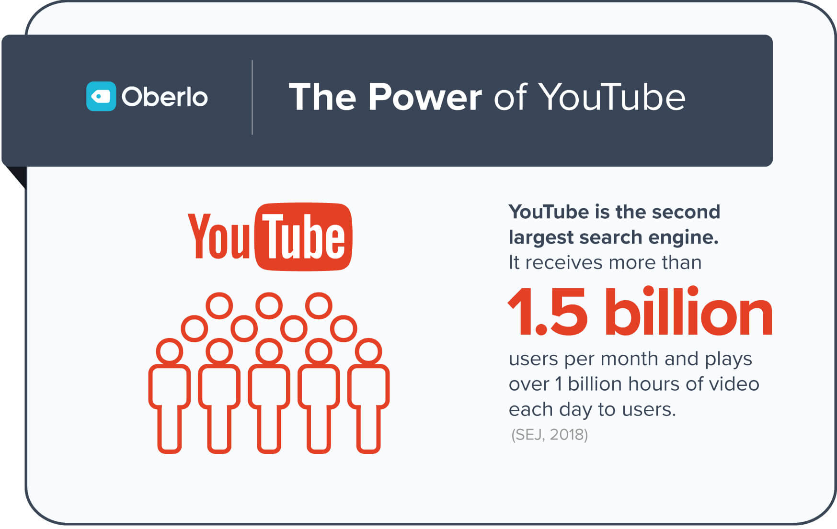
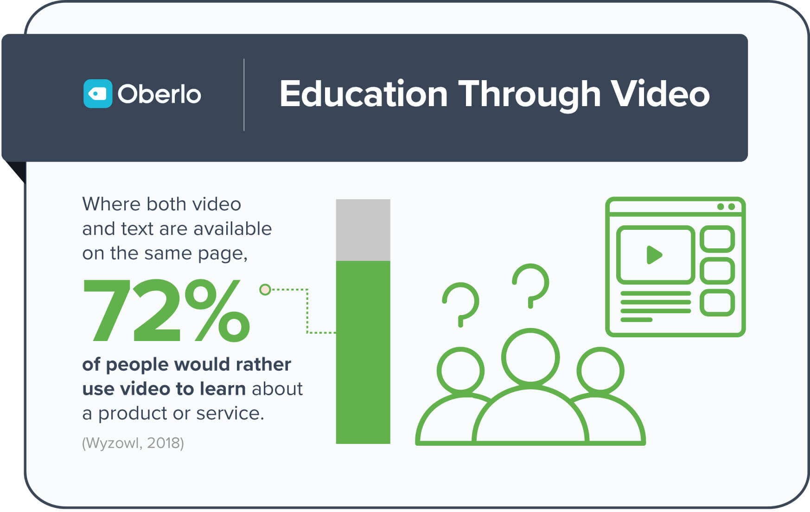
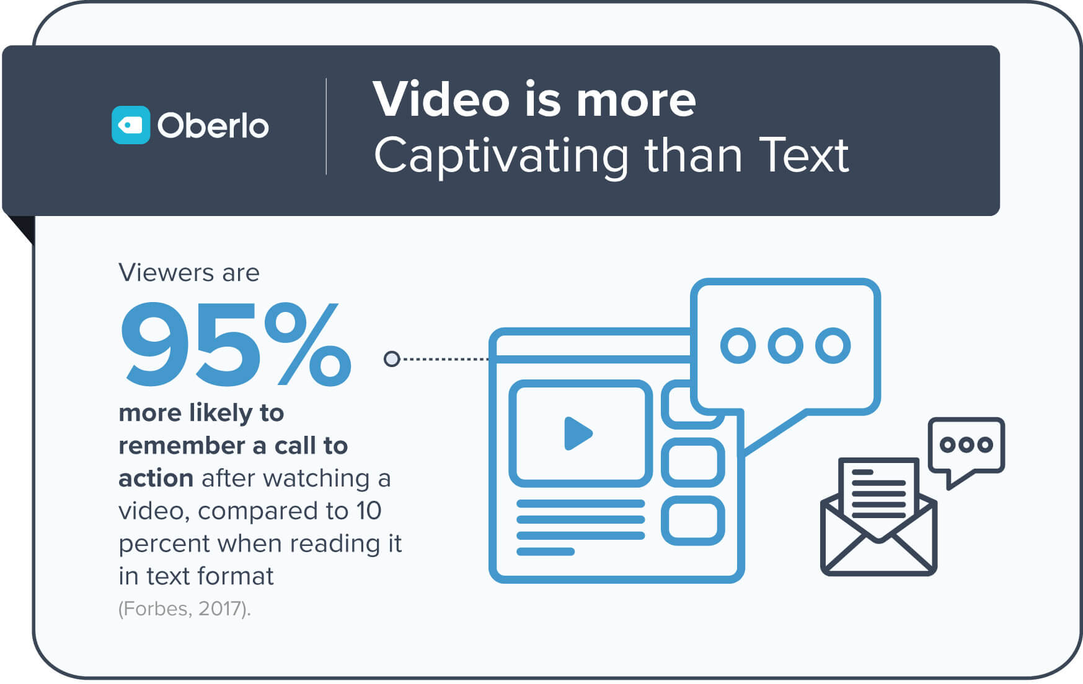
Manchester
Notes:
Overview of why video is so important to social media and marketing content in 2019

Slide 62
Case study – Fire It Up – Apprenticeships campaign (Department for Education)
Manchester
Notes:
Case studies of organisations using video effectively
Practical tips on how to create better video on a small budget

Slide 63


Slide 65
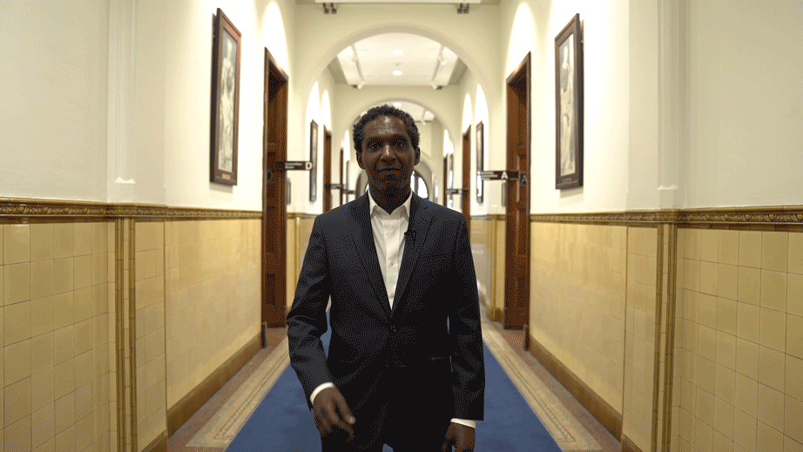
Manchester
Creating better video on a small budget
Experiment with GIFs
Make your videos square/vertical and under 1 minute (Facebook now wants videos 3 minutes +)
Caption everything
Make recognisable faces the key focus of your videos
Get out internally and be prepared to shot, edit, release within a couple of hours
Notes:
In similar ways, we’ve used social to bring our community closer to our leadership.
Whether that’s through interactive GIFs from our Chancellor, poet Lemn Sissay during our graduation ceremonies, or personalised GIF content we sent out to new students celebrating on results day.

Slide 66
Manchester
Creating better video on a small budget
Notes:
We’ve made improvements in the past 12 months around academic engagement, regularly providing researchers a showcase to talk about their world-leading work. Here’s an example, with academics providing ‘diary room’ style predictions from their offices. It’s natural, genuine and didn’t take a lot of equipment or editing time. The experts are speaking directly to a viewer, so viewers can directly identify and learn from them, like they’re in the same room.
These 15-30 second clips were released via social at the start of January. Increasingly, social videos are watched with the sound off, so we subtitle or caption all of our content to make it accessible. We use a square size or vertical format, which takes up more space on a mobile screen than a traditional 16:9.
We think about content with a mobile-first mindset, as we know that 9 in 10 of the 3 billion people that use social each month, do so via mobile. (We Are Social, 2018).

Slide 67
Manchester
Creating better video on a small budget
Notes:
https://youtu.be/WXiOXCmZ14I
We’ve put students at the heart of our content. Here’s a nice example of content produced with student ambassadors to help new students before they arrived on campus in September.
Again, it follows the square format, with additional captions and graphics to encourage engagement and shares. This was viewed over 8,000 times in September 2018.

Slide 68
Notes:
AB. 5 MINUTE BREAK.

Slide 69
Social Analytics – measuring what matters
Notes:
Why analytics matter
How analytics can help you gain executive buy-in and develop your social media
How you can use analytics to tell a powerful story internally
Understanding analytics and what you should measure and why
How to use analytics to make your content more effective

Slide 70
What do you currently measure?
Notes:
AB. Ask the audience.

Slide 71
Key metrics for social media
Engagements
Best way to understand how your content is performing
Reach and demographics
Indication of size of audience and who they are
Referral traffic
How many users click through to key webpages and where they’ve come from
Google Analytics
Twitter Analytics
Instagram Analytics
Facebook Insights
(Pages and Groups)
Notes:
AB

Slide 72
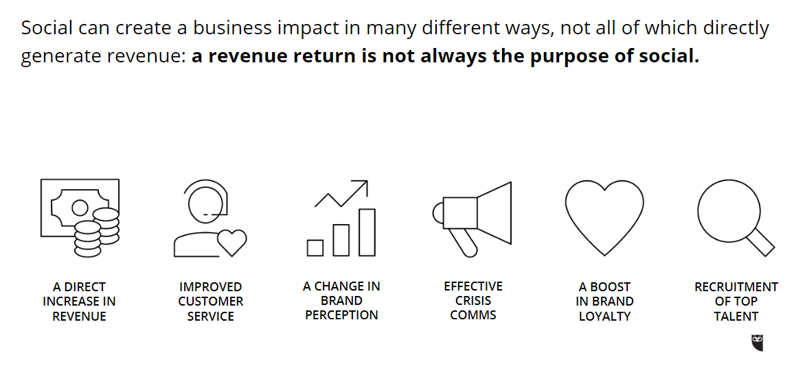
What is social ROI and what does it mean?
Source: Hootsuite, 2019

Slide 73
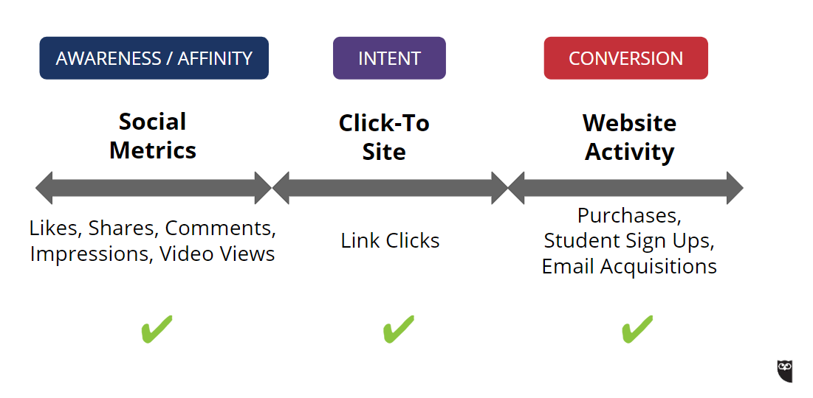
Example ROI spectrum
Source: Hootsuite, 2019

Slide 74
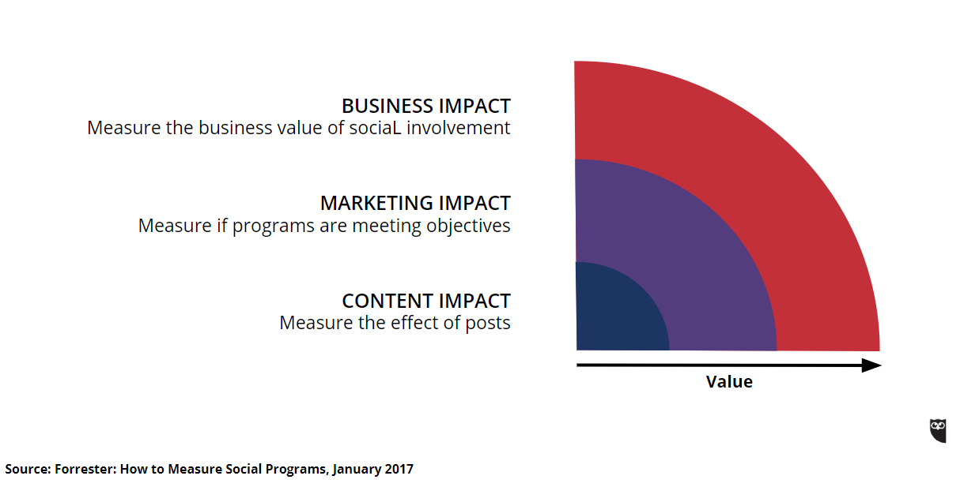
Manchester
The socially mature organisation
Notes:
Introduction to the social media maturity model and why it matters
USE HOOTSUITE MODEL

Slide 75
Adding social into your customer service
Notes:
Why customer service on social media is so important to the public sector
The difference between customer service on social media and ‘social customer service’
The risks and opportunities of social customer service
Social customer service case study:
Humans not Robots: How ‘being human’ online will revolutionise your social customer service
The importance of having a ‘social customer service playbook’ and how to create one

Slide 76
Why customer service on social media is so important
69%
say direct messaging makes them feel more confident about a company
64% of Twitter customers expect a response within 1 hour
80% expect a response within 24 hours
Source: Hootsuite and Hubspot, 2019
Notes:
Why customer service on social media is so important to the public sector

Slide 77
Why customer service on social media is so important to the public sector
Notes:
Why customer service on social media is so important to the public sector
The difference between customer service on social media and ‘social customer service’
The risks and opportunities of social customer service
Social customer service case study:
Humans not Robots: How ‘being human’ online will revolutionise your social customer service
The importance of having a ‘social customer service playbook’ and how to create one

Slide 78
Why customer service on social media is so important to the public sector
Customer
experience
increasingly defined
by online
interactions
Social customer
service
is the new
marketing
Channels are
shop windows into an org
Notes:
Why customer service on social media is so important to the public sector
The difference between customer service on social media and ‘social customer service’
The risks and opportunities of social customer service
Social customer service case study:
Humans not Robots: How ‘being human’ online will revolutionise your social customer service
The importance of having a ‘social customer service playbook’ and how to create one

Slide 79
Why customer service on social media is so important to the public sector
Social customer
service
changes the
relationship between
customers and orgs
Customer service
is now public – the
world can see how
you talk to
customers
Often the first place people interact with your org
Notes:
Why customer service on social media is so important to the public sector
The difference between customer service on social media and ‘social customer service’
The risks and opportunities of social customer service
Social customer service case study:
Humans not Robots: How ‘being human’ online will revolutionise your social customer service
The importance of having a ‘social customer service playbook’ and how to create one

Slide 80
The difference between customer service on social media and ‘social customer service’
Social customer service is about building relationships and skills in the art of conversation
This is tough if customer service teams lack the skills of experience communicators or lack the understand of what’s changed with the maturity of social media channels
There could be an aversion to risk / change from traditional customer service teams
Notes:
AB.

Slide 81
 | Customer service on social media | Social customer service
Managed by | Marcomms staff with some knowledge of product and customer base | A mix of marcomms and customer service staff, with expert knowledge of customer wants and needs. Customer triage in place.
Risks | Lack of specialist knowledge leads to delays in resolving enquiry. Likely to be low down on individuals priority work list – intermittent responses | Enterprise-level social media management tool required, with multiple licences. On-going training and collaboration between teams required
Opportunities | Marcomms to empower customer service teams and collaborate through shared Inbox. | Set organisational response times and benchmark against industry competitors Integrate CRM
Best for | Small agencies or companies who don’t have a dedicated customer service function and customer enquiries at a manageable level | Large-scale organisations with customer service function in place and resources available to invest in social media management tool
Notes:
The difference between customer service on social media and ‘social customer service’
The risks and opportunities of social customer service

Slide 82
Social customer service case study:
The University of Manchester (@OfficialUoM)

Slide 83
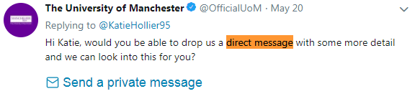
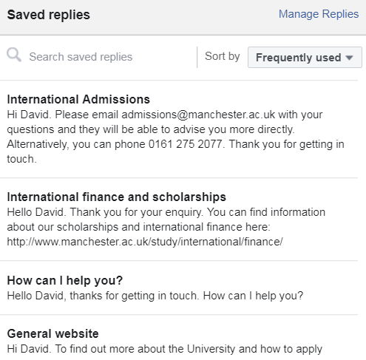
Take sensitive / difficult conversations ‘offline’
Regularly review your
auto-response messages for
currency / clarity
Personally signing off messages
can help placate aggrieved customers, but this must be
agreed practice within your
social media team

Slide 84
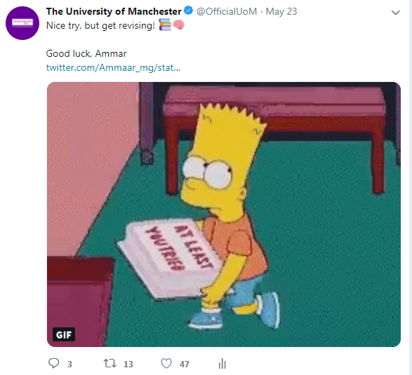
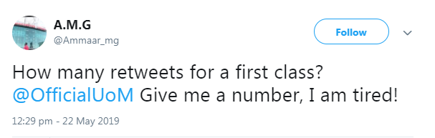
Work hard on your tone of voice –
make sure it aligns with existing brand guidelines
Elevate ‘safe’, fun engagements with quote retweets
Like engagements / @mentions when they’re appropriate to be seen by wider audiences

Slide 85
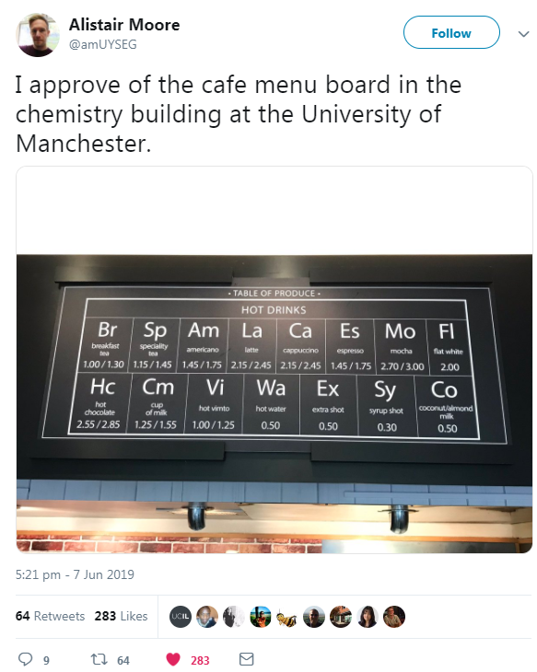
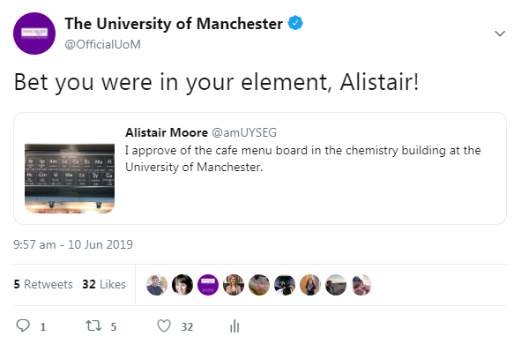
Puns can fall flat, or give your brand some personality – particularly internally if you’re engaging back and forth with staff

Slide 86
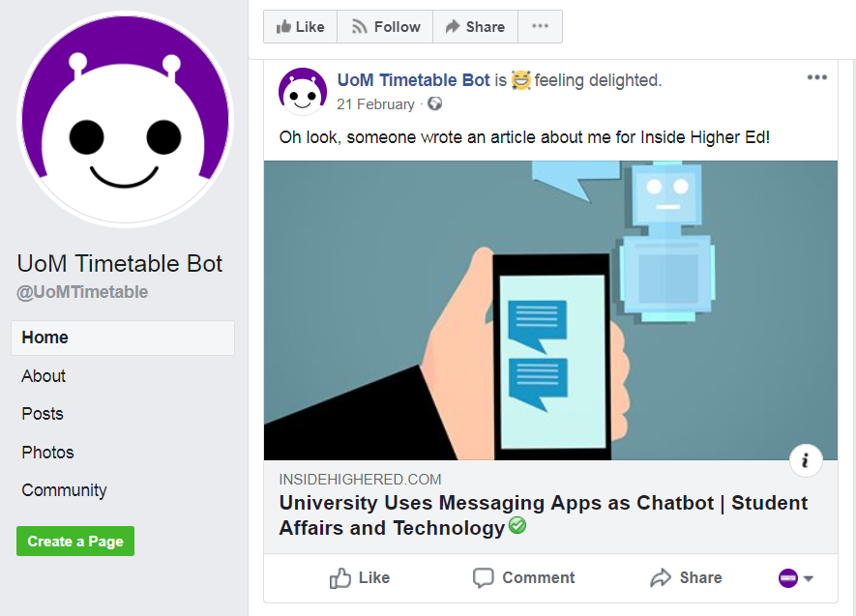
Humans not robots – or a combination of both?
Notes:
Talk about chat bots at UoM.
Genie app at Deakin.

Slide 87
Humans not robots – or a combination of both?
Notes:
Talk about chat bots at UoM.
Genie app at Deakin.

Slide 88
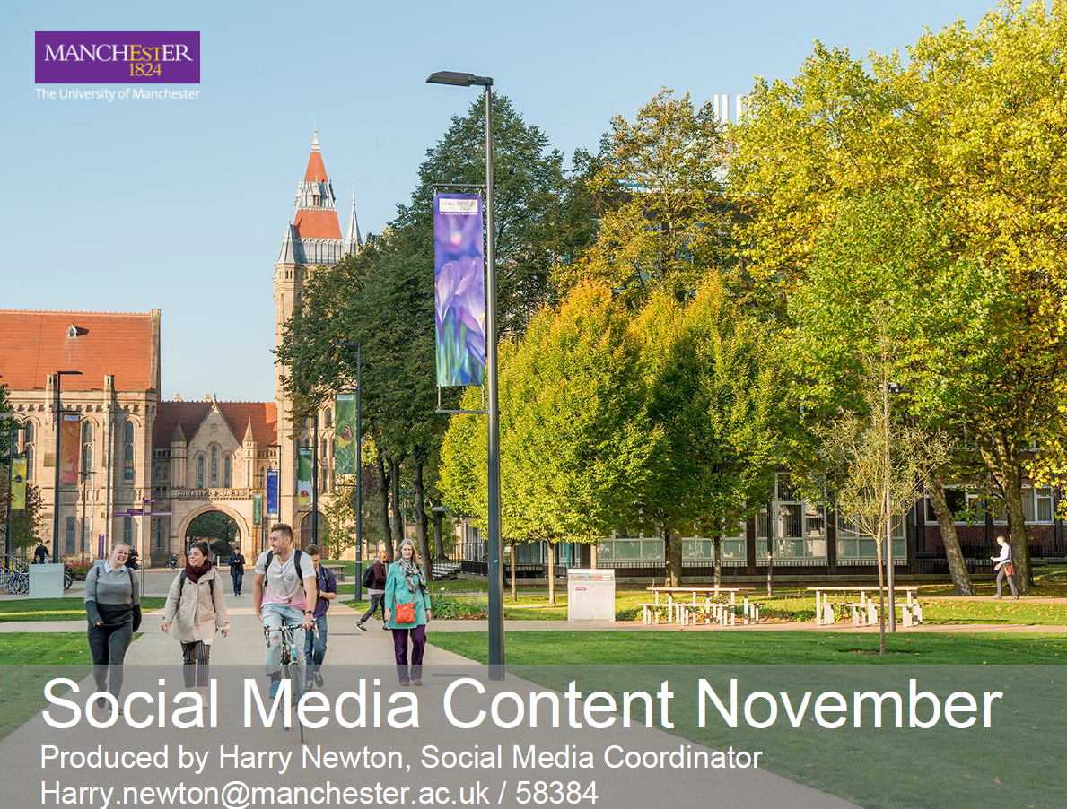
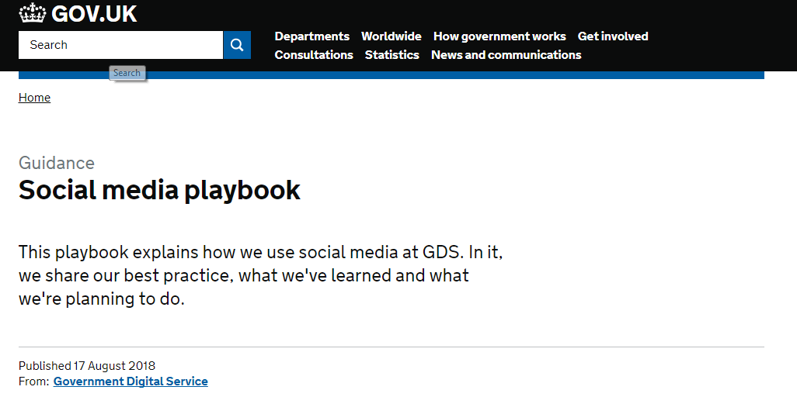
SM playbook
Notes:
https://www.gov.uk/guidance/social-media-playbook

Slide 89
Key learning objectives
Actionable insights to help you plan a strategic, long-term way of approaching and using social media within your organisation
Think about social media in new ways – start making progress straight away whilst working towards larger objectives

Slide 90
Exercise: spend five minutes reflecting on today’s worksheets and materials
What three actions will take back to your workplace tomorrow morning – and implement?

Slide 91
Q&A session

Slide 92
Good luck and keep in touch! alistair.beech@manchester.ac.uk
linkedin.com/in/alistairbeech
@alistairbeech

